Slide 1





Evaluation of covariate effects using forest plots and introduction to the coveffectsplot R package
JF Marier, Nathan Teuscher and Samer Mouksassi James Craig, Dean Attali, Benjamin Rich
https://github.com/certara/R-Certara

Slide 2
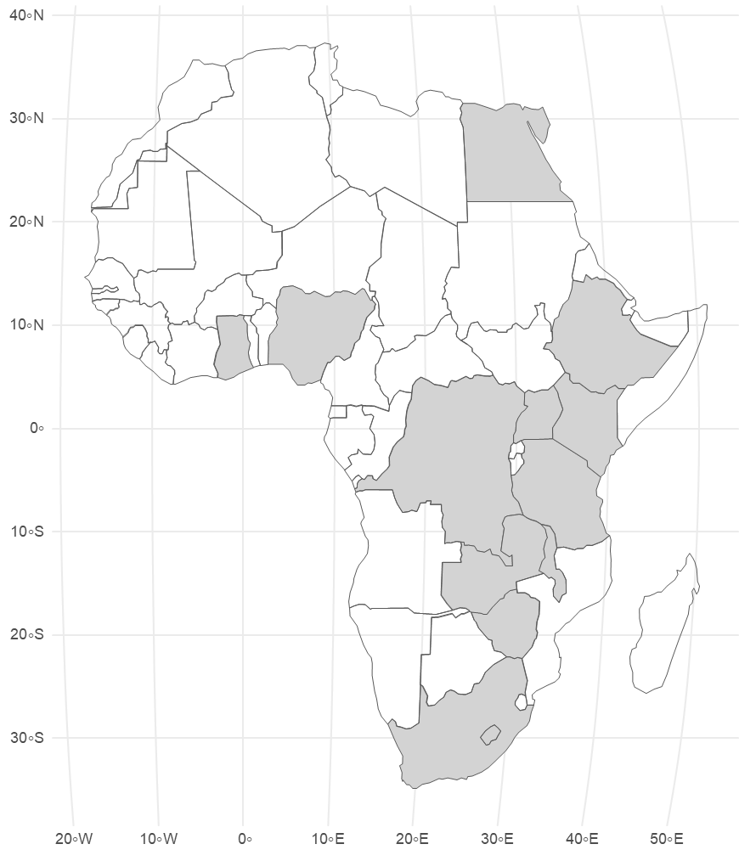

Samer Mouksassi
Samer has worked at Pharsight/Certara since 2007 covering statistics, NCA, pharmacometrics, global public health, real world data and model-based meta-analysis. He attained a MSc. in Biostatistics and epidemiology before completing his Ph.D. in Pharmacometrics from the University of Montreal, where he built population PK/PD models of the effects of local anesthetics on pain after knee or hip replacement surgeries.
His current role at Certara as Senior Director – Africa region Lead involves mentoring and building new pharmacometrics teams in Cairo (Egypt) and Cape Town (South Africa).
Certara with Pharmacometrics Africa are currently running the African applied pharmacometrics training (APT) fellowship program for the second year. The goal is to create a sustainable ecosystem for pharmacometrics in Africa where modeling and simulation/quantitative methods are used to optimize drug development decisions.
Samer has served has an ISOP education committee lead and is part of the ISOP MOEV team. He has a passion for teaching and to building tools that empower non-coders to communicate efficiently. He is the author of coveffectsplot, ggquickeda and tidyvpc R packages.
3
2
https://github.com/certara/R-Certara

Slide 3

What will you cover today
Define what are effects plot
How to generate (simulate) the effects of our covariate models including uncertainty
Getting started using the coveffectsplot package to effectively communicate your covariate models

Slide 4
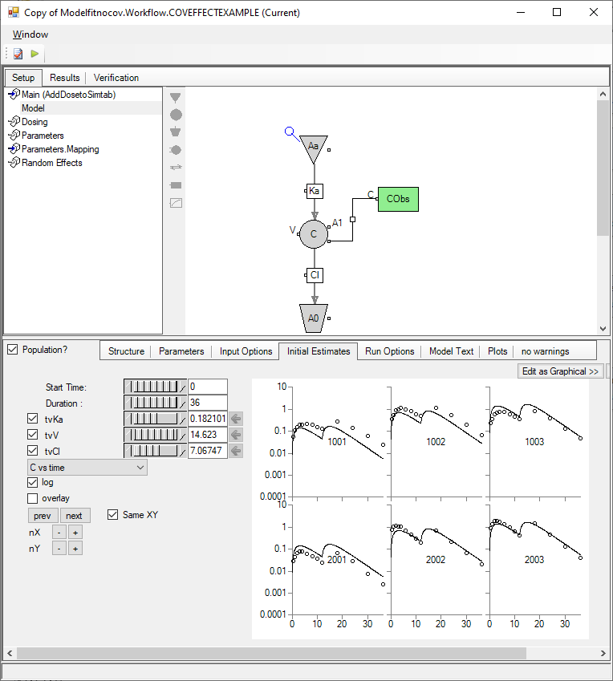
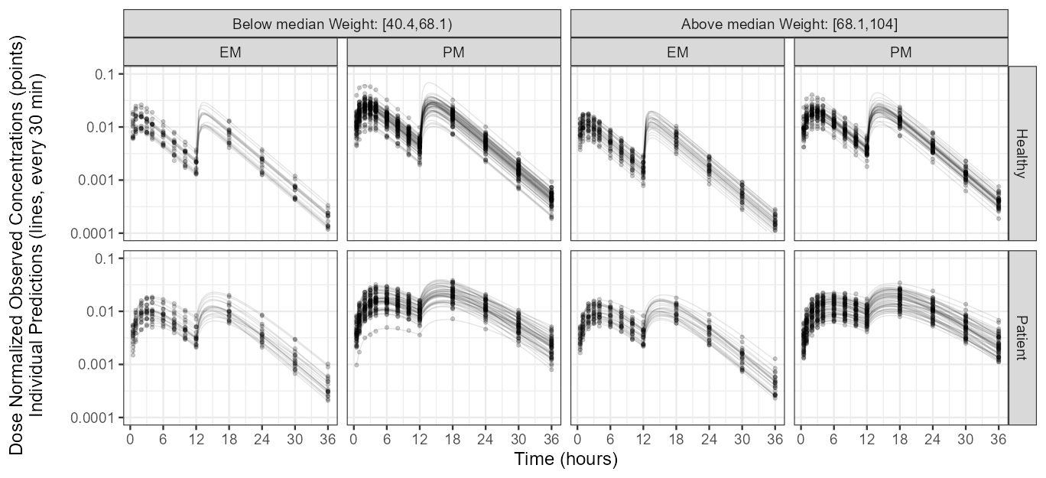
Effects Plots from pharmacometrics models
Dependent variable is Drug Concentrations
Curve described using a nonlinear mixed effects model
Clearance, Volume, Ka, covariates impact model parameters
CL = POPCL × (Weight/70)^{dWTdCL} × exp(dCldEM1×(EM==1)) × exp(ηCL)

Slide 5
Effects Plots
CL= POPCL × (Weight/70)^{dWTdCL} × exp(dCldEM1×(EM==1)) × exp(ηCL)
log(CL)= log(POPCL) + dWTdCL×log(Weight/70) + dCldEM1 ×(EM ==1) + ηCL
Given a model equation we are interested to compute the marginal effects at a representative values (mean, median, most frequent) of predictors/covariates/features from statistical models of parameters

Slide 6
Effects Plots
CL= POPCL × (Weight/70)^{dWTdCL} × exp(dCldEM1×(EM==1)) × exp(ηCL)
log(CL)= log(POPCL) + dWTdCL×log(Weight/70) + dCldEM1 ×(EM ==1) + ηCL
Given a model equation we are interested to compute the marginal effects at a representative values (mean, median, most frequent) of predictors/covariates/features from statistical models of parameters
This is done by computing predictions generated by a model when one varies the effect variable while holding the other variables constant
e.g.: illustrate the effect of Weight while keeping EM =0 (reference) we can also predict the weight effect at EM = 1 or any combination of variables of interest (but will it be “representative” of the population ?)

Slide 7
Effects Plots
CL = POPCL × (Weight/70)^{dWTdCL} × exp(dCldEM1×(EM==1)) × exp(ηCL)
log(CL) = log(POPCL) + dWTdCL×log(Weight/70) + dCldEM1 ×(EM ==1) + ηCL
Given a model equation we are interested to compute the marginal effects at a representative values (mean, median, most frequent) of predictors from statistical models of parameters
This is done by computing predictions generated by a model when one varies the effect variable while holding the other variables constant
e.g.: illustrate the effect of Weight while keeping EM =0 (reference) we can also predict the weight effect at EM = 1 or any combination of variables of interest (but will it be “representative” of the population ?)
Usually, we are not interested in the effects on model parameters e.g. CL, Volume, Vmax rather we want to assess the impact on exposures such as AUC, Cmax
We want use the uncertainty (standard error) → 95% or 90% CI of model parameters
We want to compare/contrast the effect of covariates to the unexplained random effects

Slide 8
Effects Plots: isolating Sources of Variability

Slide 9
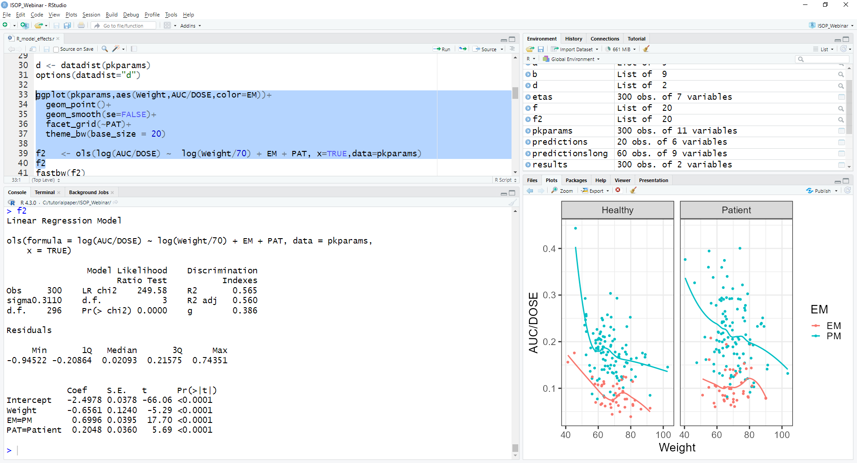
Effects Plots in R

Slide 10
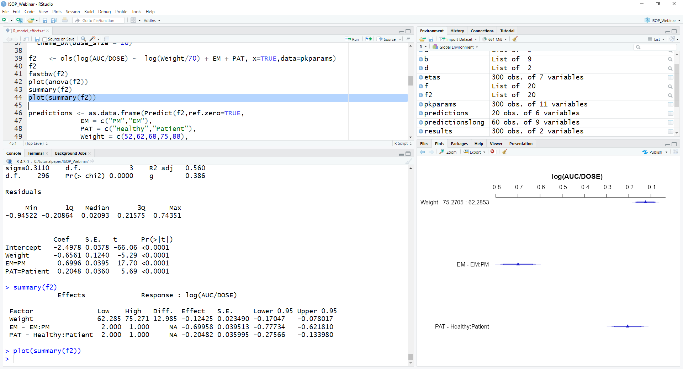
Effects Plots in R

Slide 11
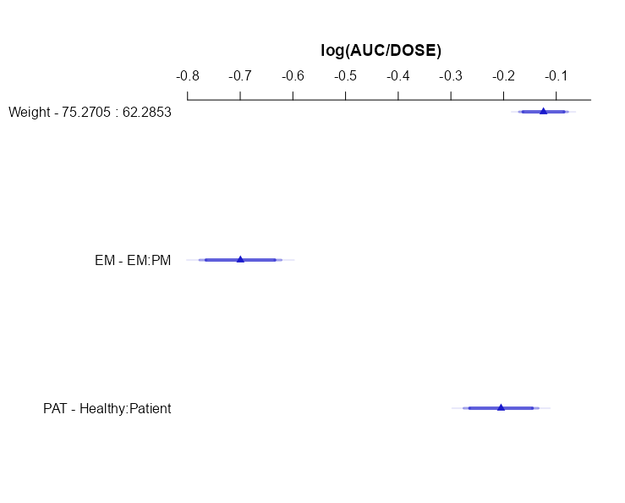
Effects Plots in R
Weight effect
75% percentile /
25% percentile
EM and PAT at reference
EM covariate effect of EM / PM
Keeping weight = 68
PAT = Patient

Slide 12
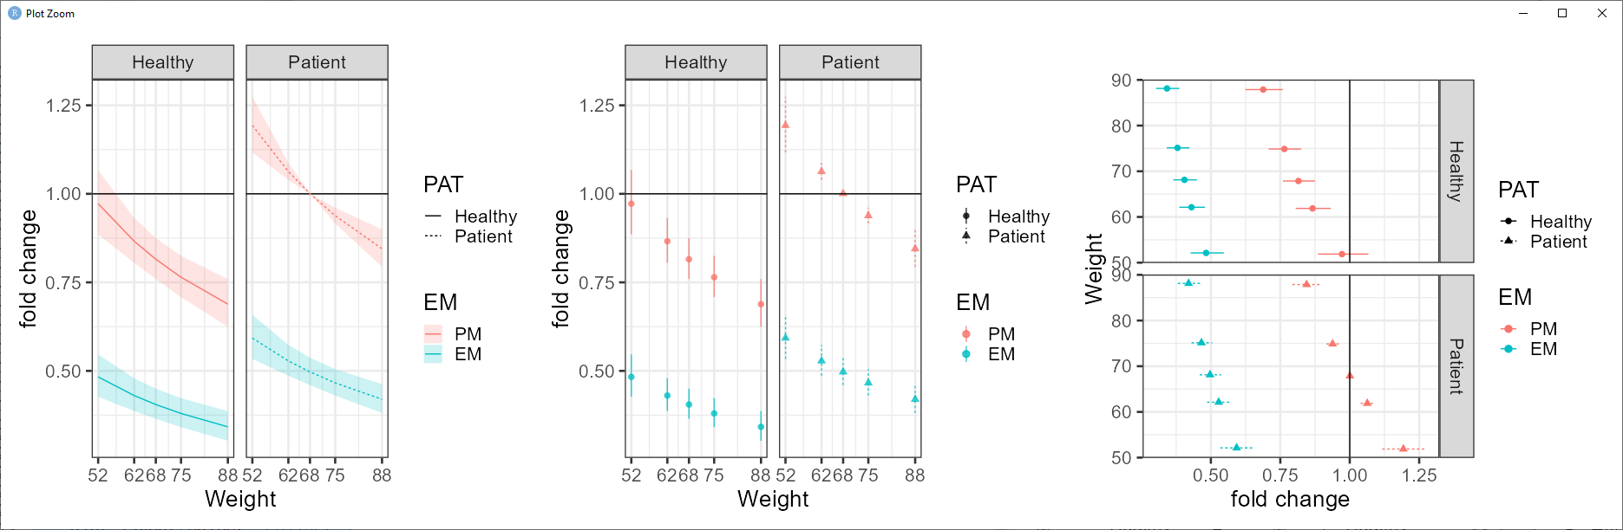
Effects Plots in R
R_model_effects.r

Slide 13
Communicating Covariate Effects
What if we have a continuous covariate? A Pop PK Model?

Slide 14
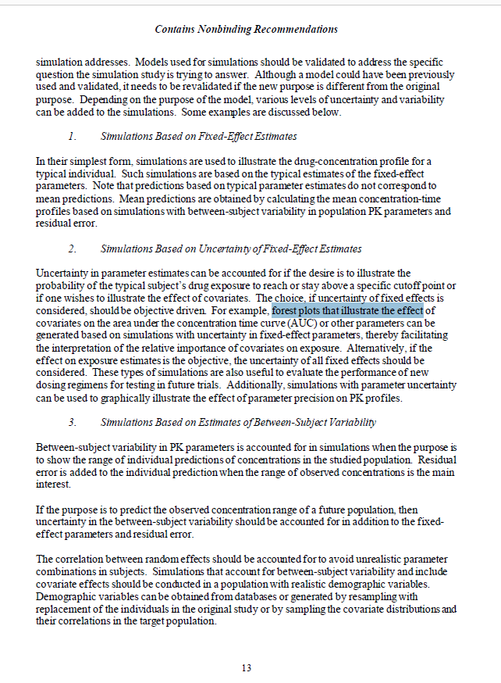
Current POPPK FDA guidance

Slide 15
Current POPPK FDA guidance
Simulation with uncertainty to illustrate effects on AUC/Relative importance of covariates/New dosing Regimens

Slide 16
Current POPPK FDA guidance
Simulation with uncertainty, BSV and realistic distributions to illustrate the impact on range of individual predictions

Slide 17
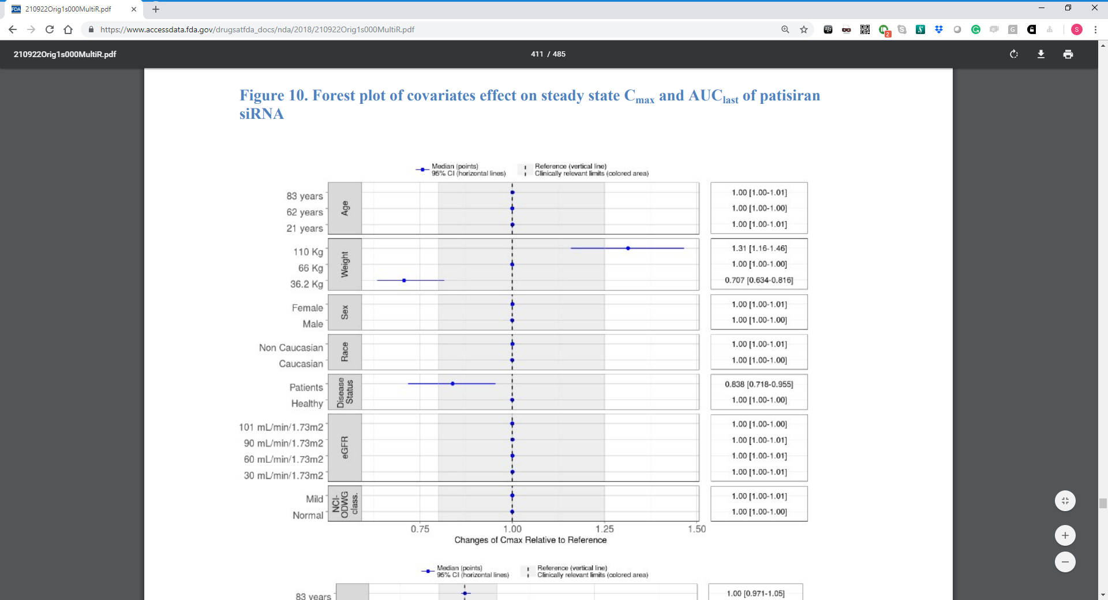
Summary basis of approvals with coveffectsplot outputs
The Applicant is asked to present a univariate and multivariate assessment of statistically significant covariates on exposure metrics (Ctrough, Cmax, AUC) and present these simulations as a forest plot

Slide 18
Menon Anderson Appendix
How much time is needed to read and understand this table?
Which concomitant drug increases exposures the most,
Which one decreases exposures the most
Are the effects similar on all exposure?

Slide 19
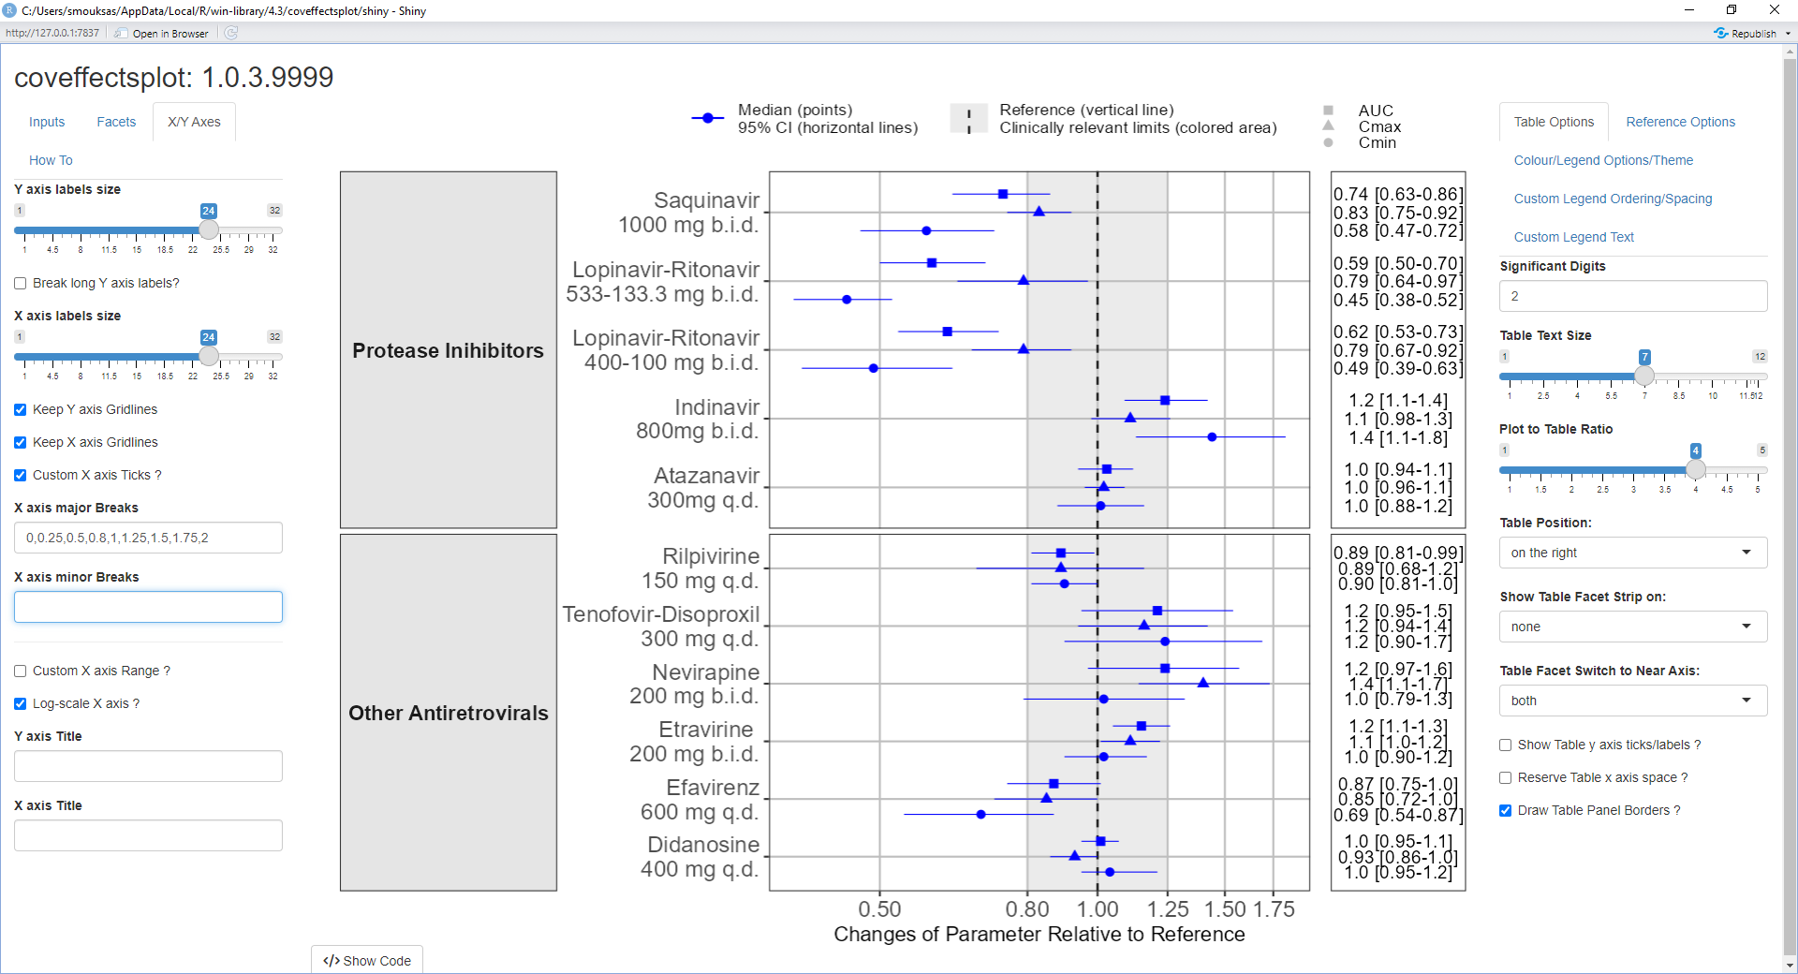
Example of what coveffectsplot can do

Slide 20
Example of what coveffectsplot can do
</>
install.packages("coveffectsplot") library(coveffectsplot)
coveffectsplot::run_interactiveforestplot(prezista)

Slide 21
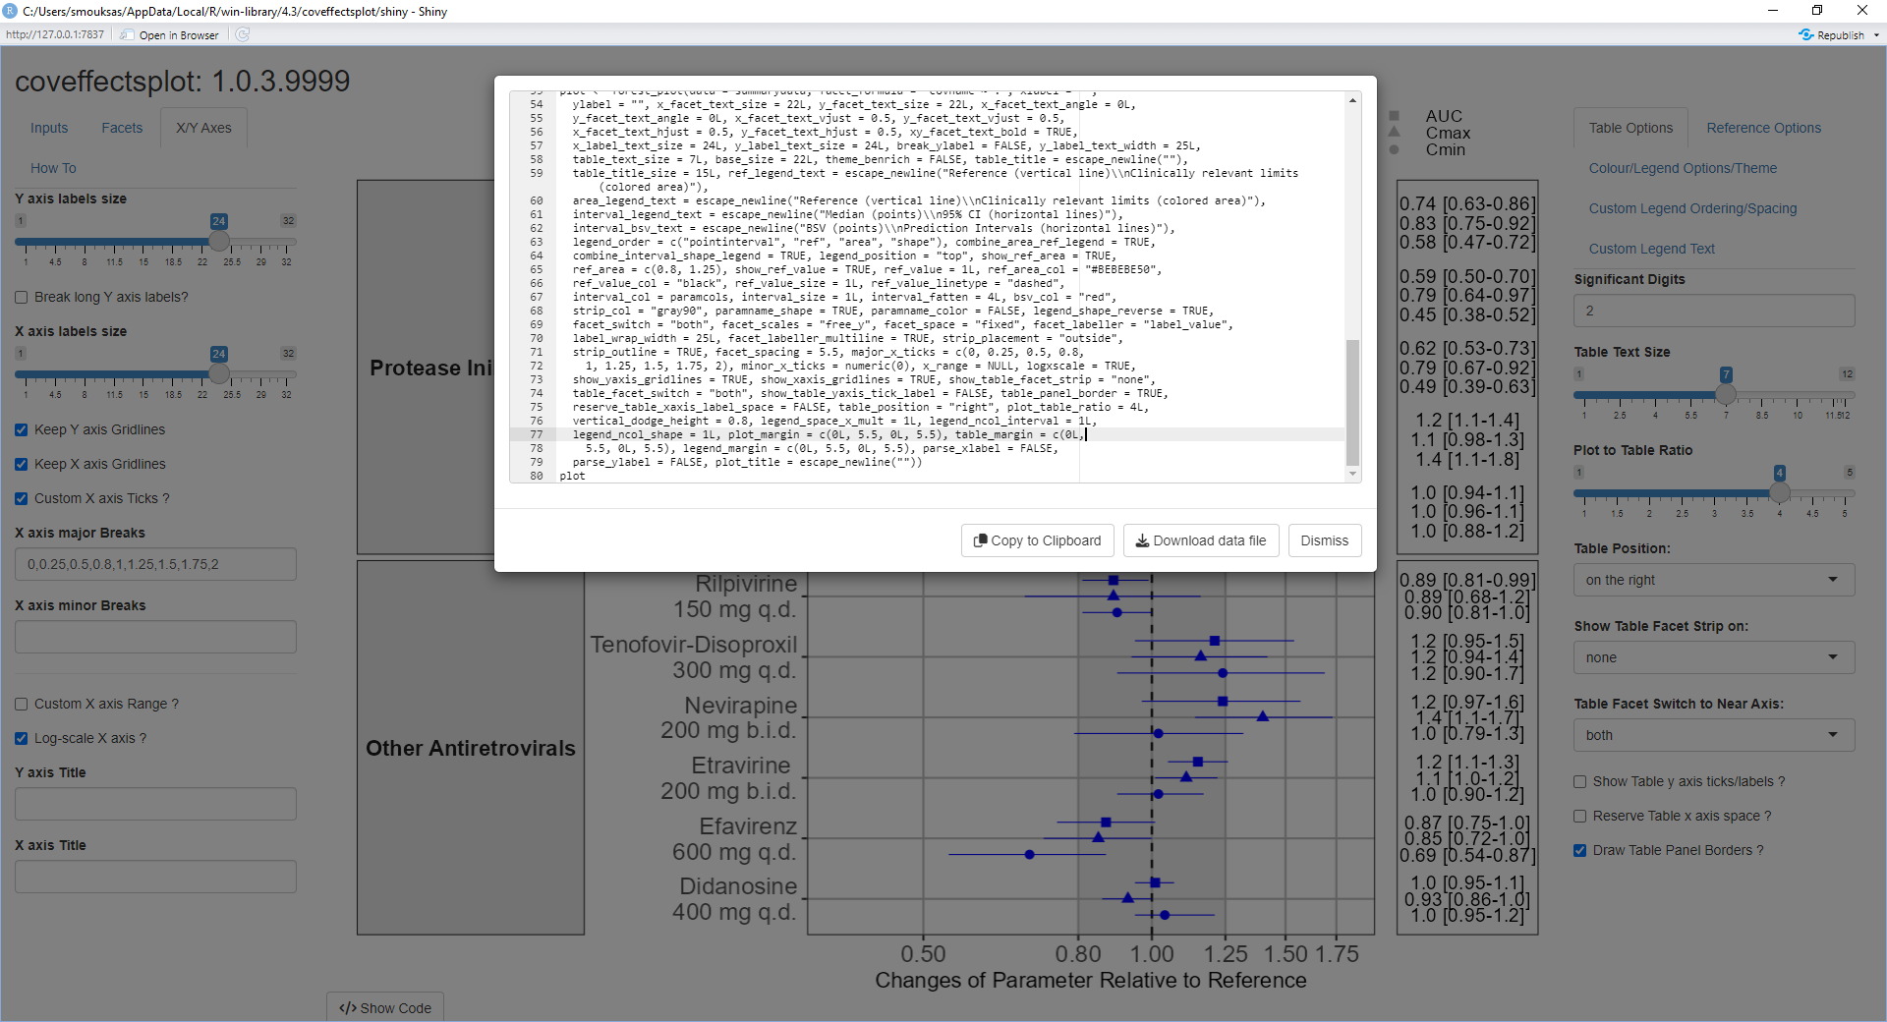
Example of what coveffectsplot can do

Slide 22
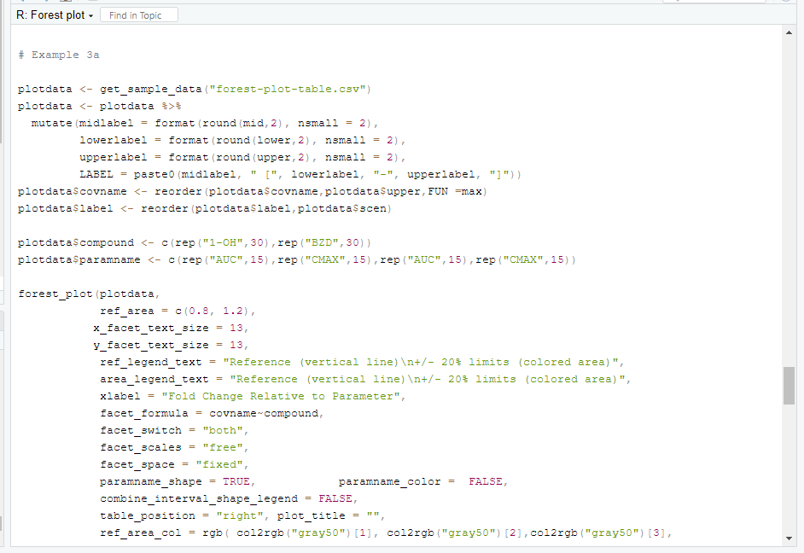
Example of what coveffectsplot can do
</>
help("forest_plot")

Slide 23
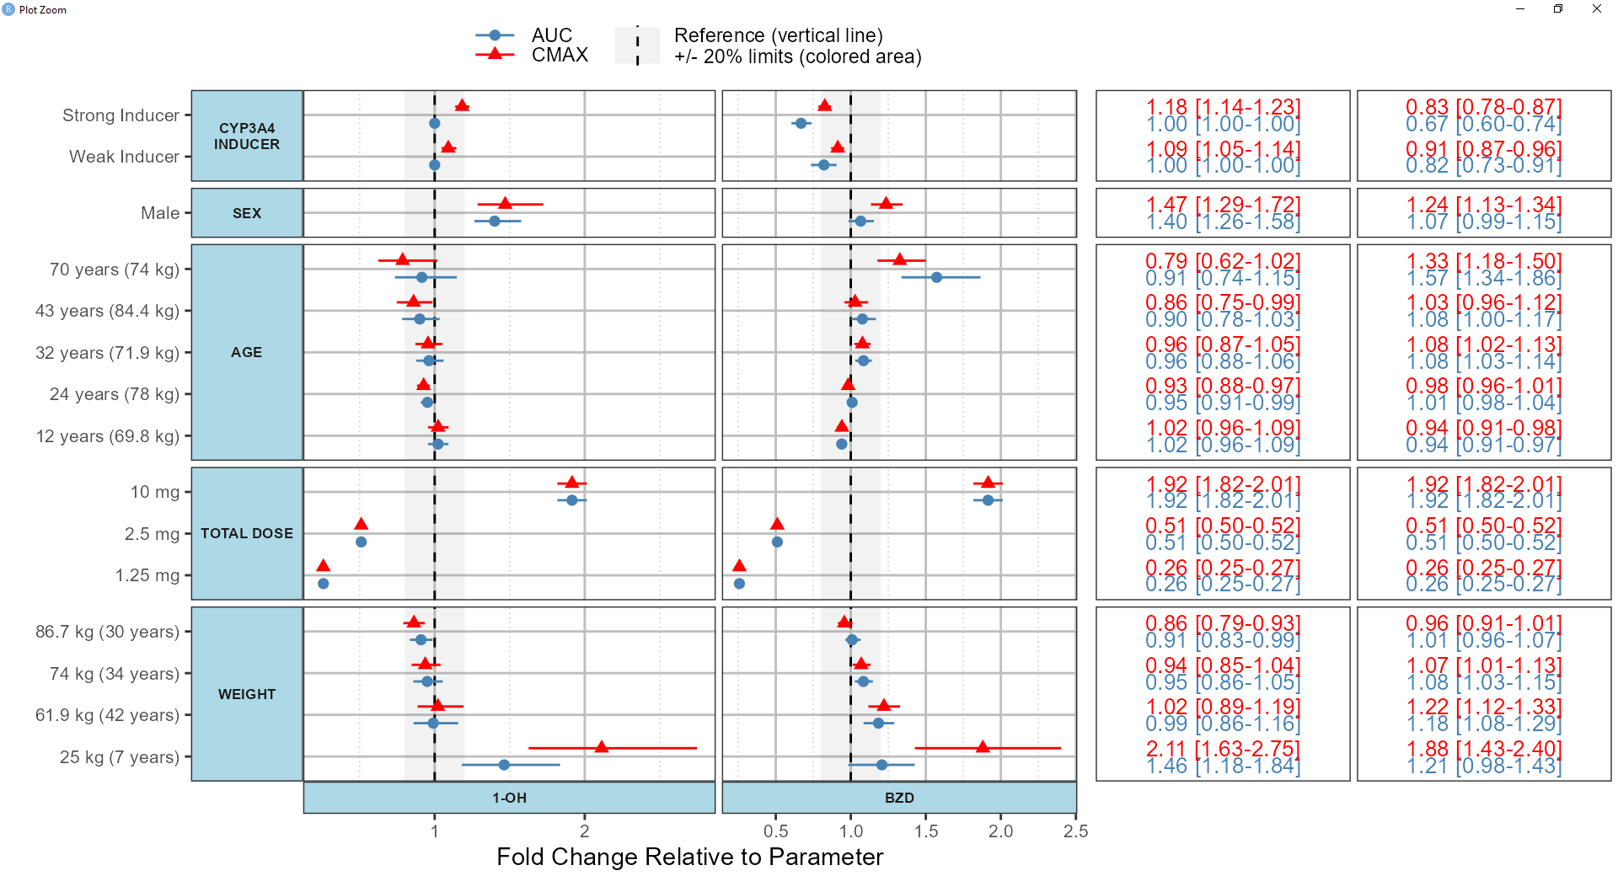
Example of what coveffectsplot can do

Slide 24
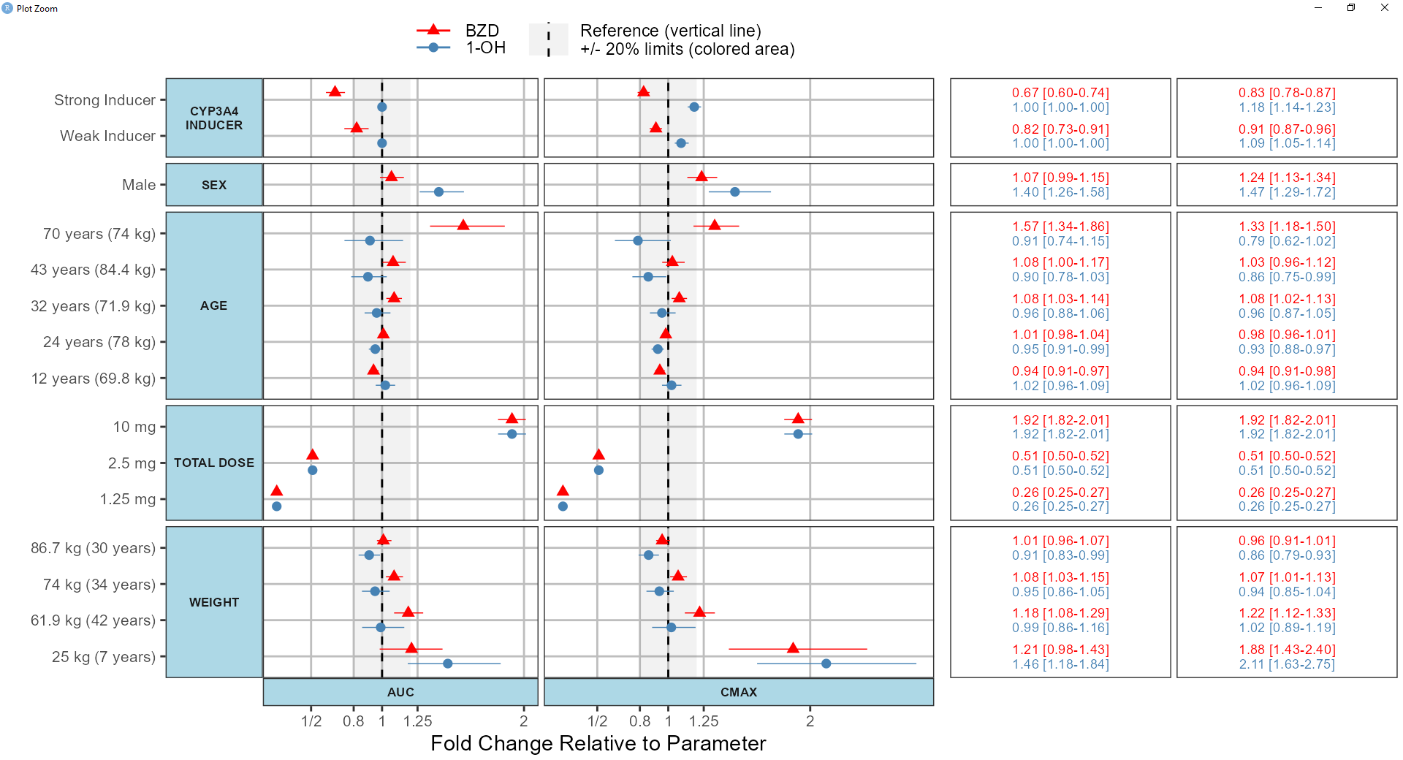
Example of what coveffectsplot can do

Slide 25
Tornado plots vs Forest plot ?

Slide 26
coveffectsplot components and design choices
legends
Covariate(s)
Parameter
Numerical Table
The value(s) of the covariate
Effect and xx%CI
Order
direction
Color ? Shape? Size ?

Slide 27
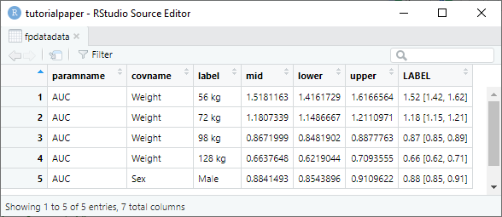
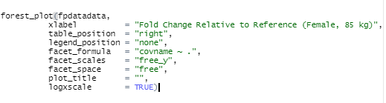
coveffectsplot minimum requirements
How to compute/generate the effects?

Slide 28
How to compute/generate the effects?
PK/PD Model
What type of Simulation ?
Fixed effects Uncertainty ? Random effects ?
varcov boot SIR
recode model into R (mrgsolve, rxode2, RsNLME etc.) data.table
Covariates Univariate
Covariates Multivariate
Database resample by patient
Compute parameters
Simulate enough replicates
coveffectsplot pmforest PMXForest NMproject
Compute intervals
Generate plots

Slide 29
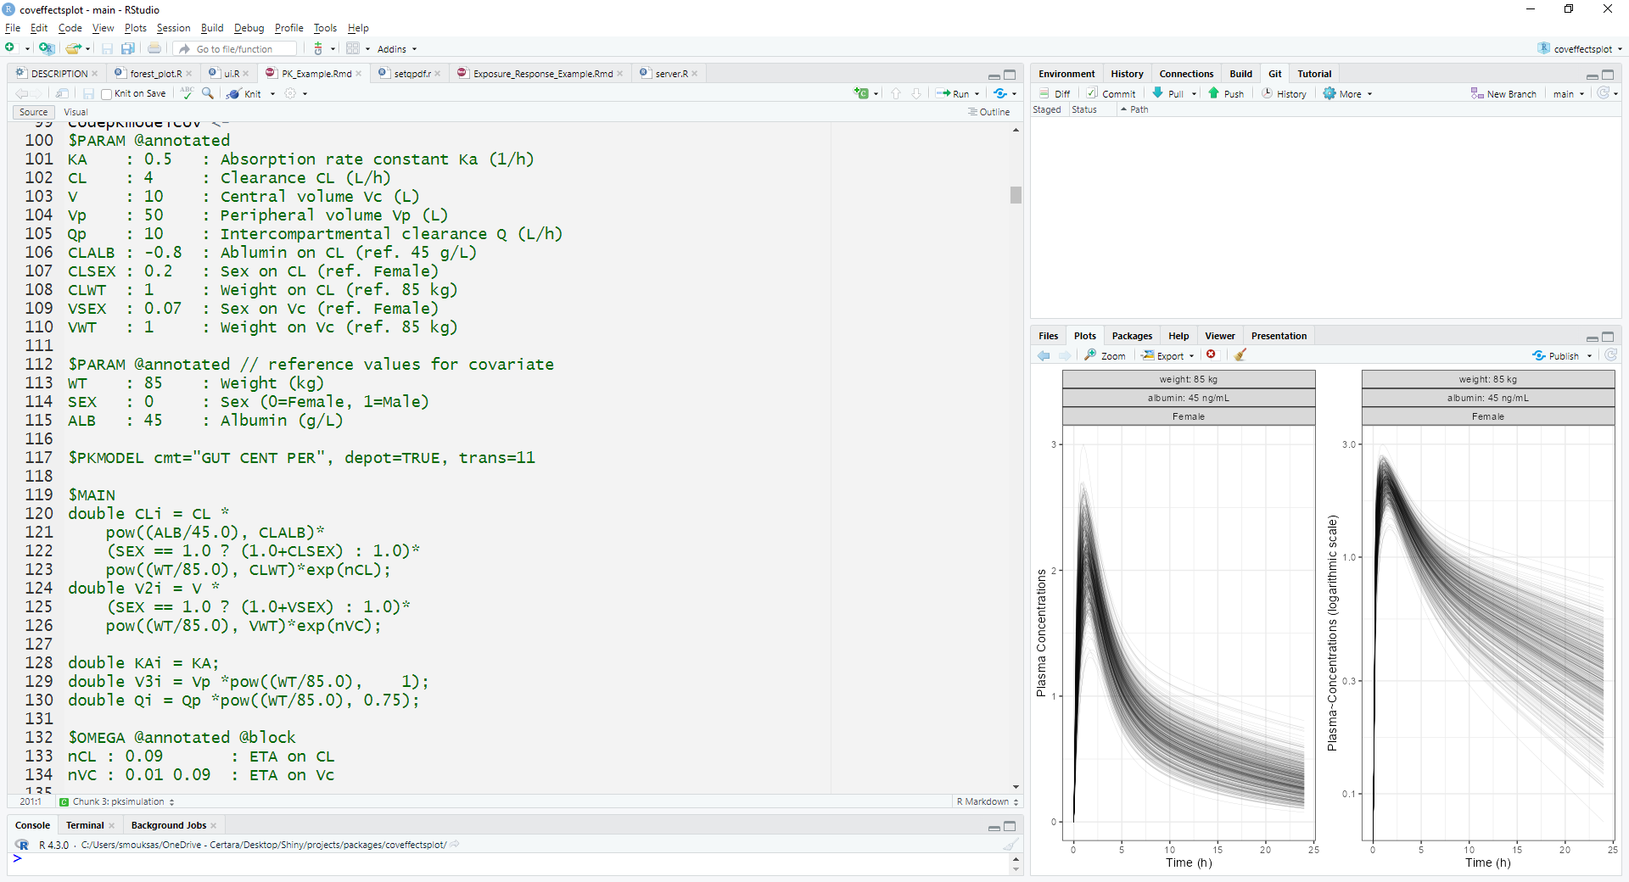
PK Model: Assessing the Marginal Impact of Covariates on Drug Exposure
https://smouksassi.github.io/coveffectsplot/articles/PK_Example.html
Covariates Univariate
Fixed effects Uncertainty No Random effects
Fixef effects (thetas)
Ref cov values
Built-in model
Parameter equations
Random effects (omega)

Slide 30
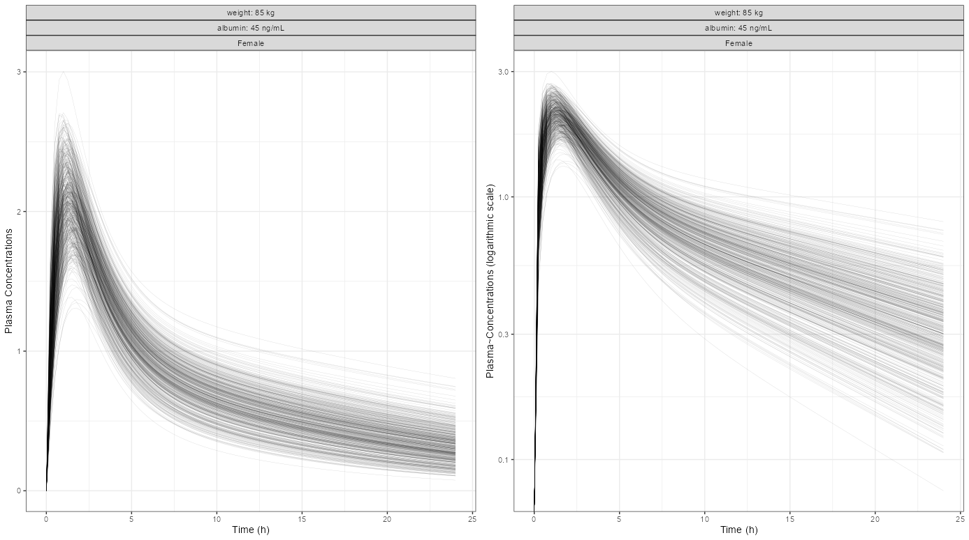
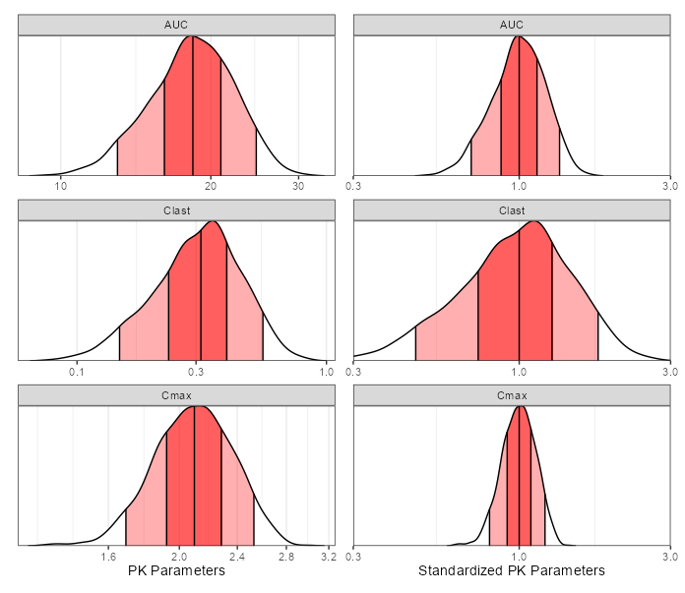
PK Model: Assessing the Marginal Impact of Covariates on Drug Exposure
PK profiles → PK parameters of interest
Compute BSV intervals at reference

Slide 31
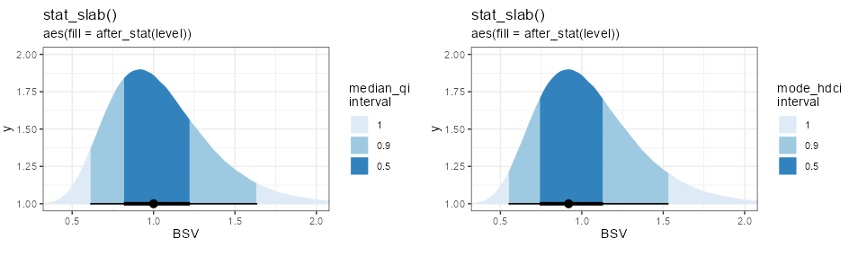
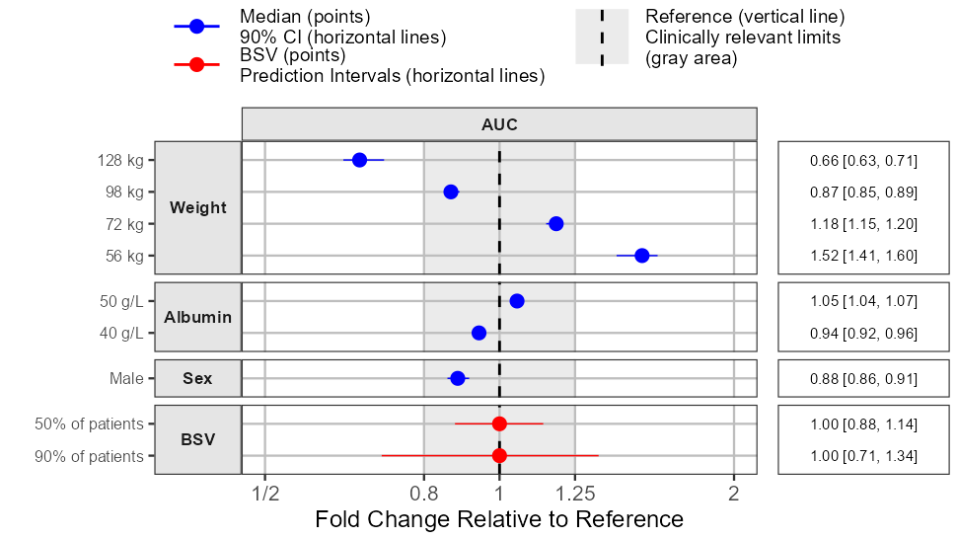
What is the meaning of BSV = XX % ?
0.82-1.22
0.74-1.13
qi_hdi.r
0.61 - 1.64
0.55 - 1.54
</>
Where is 50 % and 90% of patients?
library(ggdist);library(patchwork)
OMEGACL <- 0.09 simeta <- rnorm(0,sd =(OMEGACL^0.5),n = 1000000)
originbsv <- data.frame(BSV = 1*exp(simeta) )
originbsv %>% ggplot(aes(y = 1L, x = BSV)) +
stat_slab(aes(fill = after_stat(level)),
.width = c(.5, .95, 1)) +
stat_pointinterval(.width = c(.5, .95)) +
scale_fill_brewer(na.translate = FALSE) +
labs(title = "stat_slab()",
subtitle = "aes(fill = after_stat(level))",
fill = "median_qi\ninterval" )+
theme_bw()+
coord_cartesian(xlim=c(0.4,2), ylim=c(1,2))

Slide 32
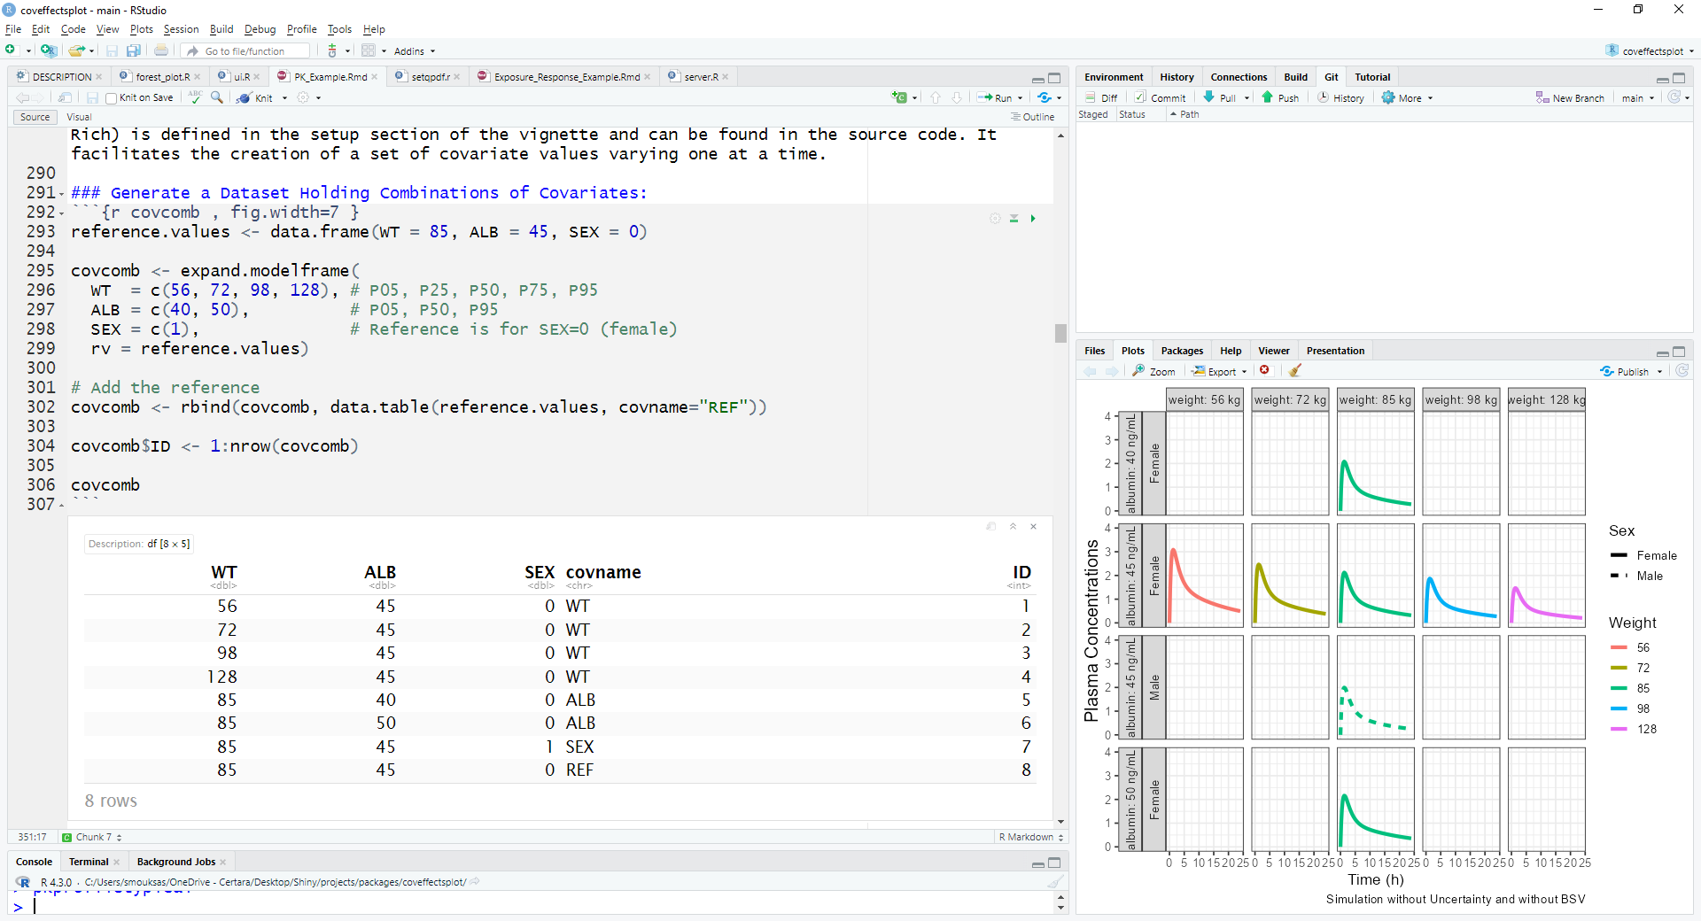
PK Model: Assessing the Marginal Impact of Covariates on Drug Exposure
covariate template

Slide 33
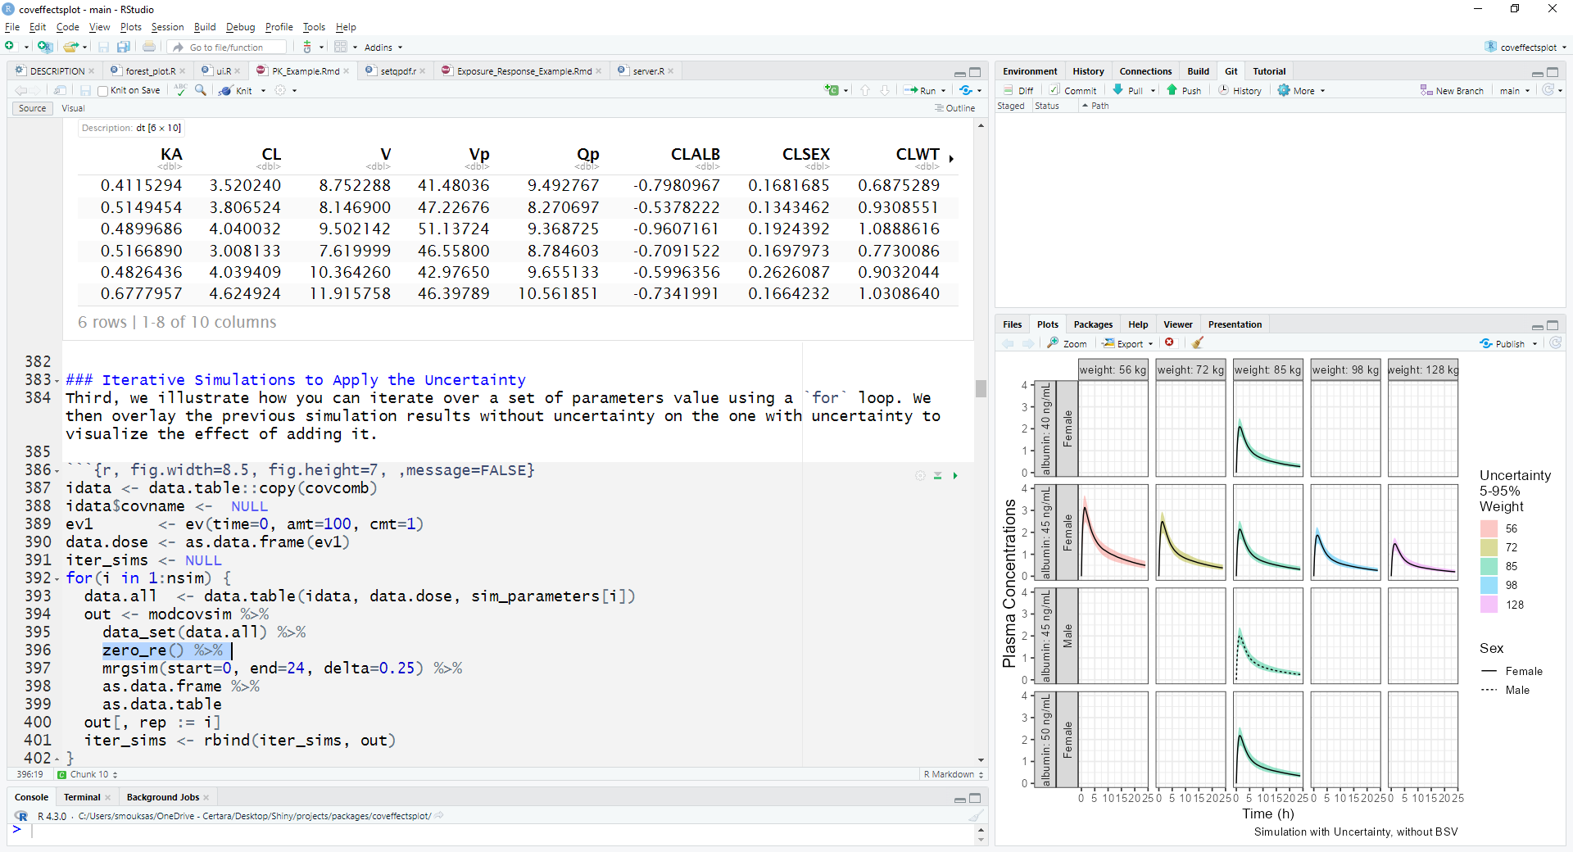
PK Model: Assessing the Marginal Impact of Covariates on Drug Exposure
Parameters uncertainty
Each replicate use a row
zeroes omega
Simulation can be parallelized with foreach or mrgsim.parallel

Slide 34
PK Model: Assessing the Marginal Impact of Covariates on Drug Exposure
BSV intervals shown at reference only to contrast with covariate effects

Slide 35
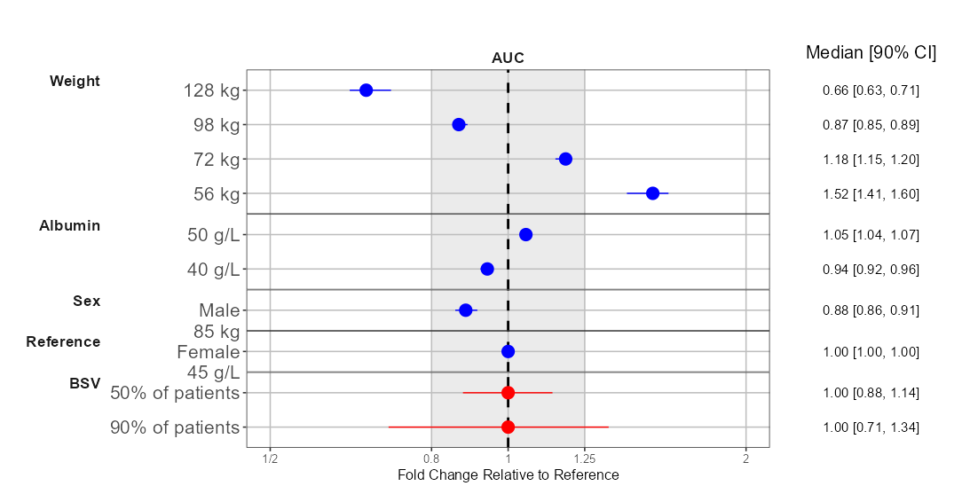
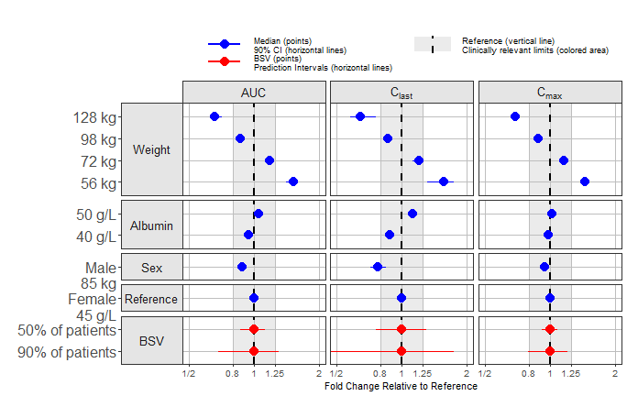
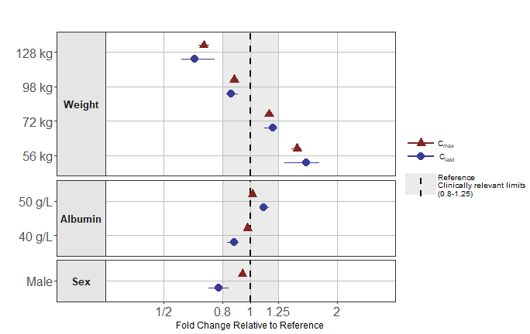
Example outputs with one or multiple parameters

Slide 36
Simulation based on uncertainty of fixed effects
1- Make a template dataset varying one covariate at time keeping the other covariate at reference
2- Simulate pk profiles (initially without uncertainty then adding it when all is set)
3- Derive exposure parameters, (e.g. AUC, C_{max} and C_{last},) at selected covariate values (e.g., percentile of covariate distributions) standardize with respect to reference values by replicate
4- Illustrate the standardized exposures using density distributions (shown), boxplots, or other. Experiment with the covariate values to show, the order of covariate and visual elements
Median
90% Uncertainty
5- Use the coveffectsplot R package
to simplify and generate an effects plot with a table and informative legends to go into a report. (AUC shown as an example)

Slide 37
Uncertainty of fixed effects + BSV + Cov dist
1-Simulate or read-in from a database realistic covariate distribution
2- Simulate PK Profiles with the covariate distribution, Uncertainty and BSV
3- Derive exposure parameters, standardize and provide a global visual representation split by medians, quartiles/tertiles to illustrate joint effects
4- Illustrate the standardized exposures using density distributions (shown), boxplots, or other. Experiment with the covariate splits to show, the order of covariate and visual elements
71%
29%
Median
90% interval of joint effects of covariate distribution, uncertainty and BSV
5- Use the coveffectsplot R package to simplify and generate a covariate effects plot for exposure parameters. The plot is report-ready with a table and legend.

Slide 38
Uncertainty of fixed effects + BSV + Cov dist
Joint Effects of all covariates split by
Quartile of weights,
Sex etc.
We can no longer show effect at one particular set of covariate values
It is hard to compare the relative importance of correlated covariates

Slide 39
Pediatric application
1- Simulate realistic Weight/Age distributions using the CDC LMS parameters
2- Simulate PK Profiles with the realistic covariate, Uncertainty and BSV
3- Derive exposure parameters, standardize and provide a global visual representation split by medians, quartiles/tertiles to illustrate joint effects
4- Illustrate the standardized exposures using density distributions , boxplots (shown), or other. Experiment with the covariate values to show, the order of covariate and visual elements
Median
50% interval of joint effects of covariate distribution, uncertainty and BSV
5- Use the coveffectsplot R package to simplify and generate a covariate effects plot on AUC, and Cmax. The plot is report ready with a table and legends.
95 %
Median
Girls
Boys
5 %

Slide 40
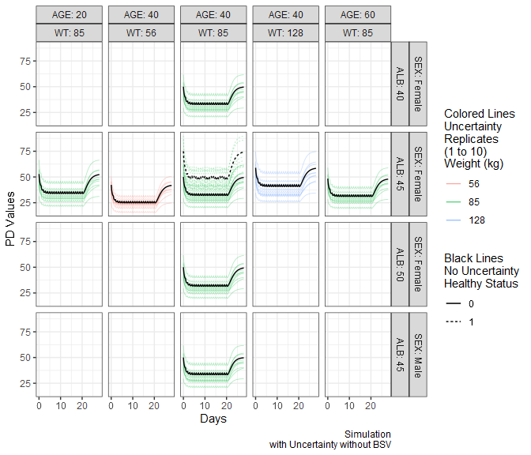
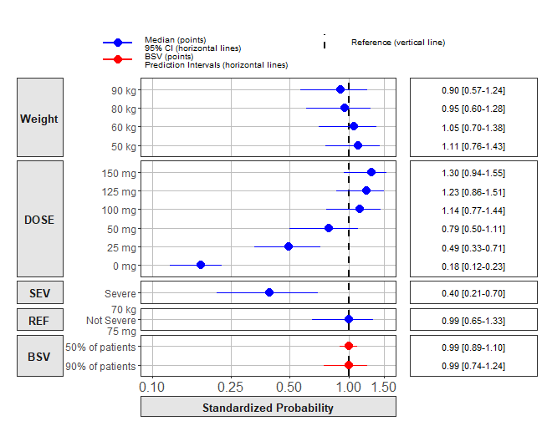
PK/PD and Exposure Response vignettes

Slide 41
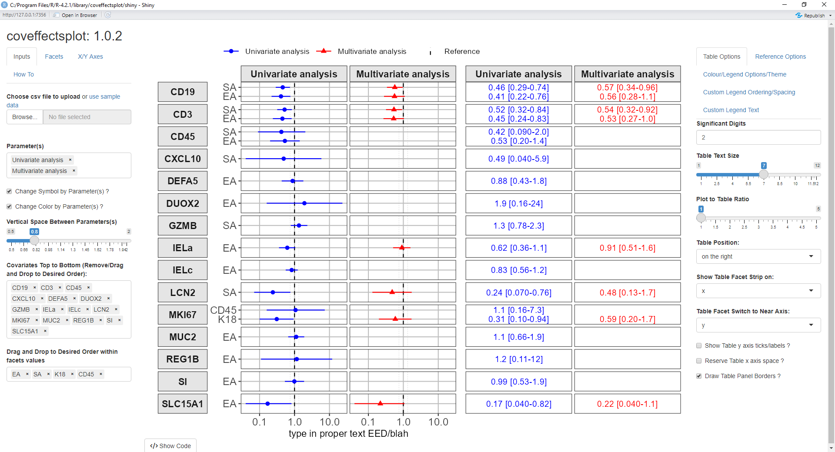
Other Uses: Compare across models

Slide 42
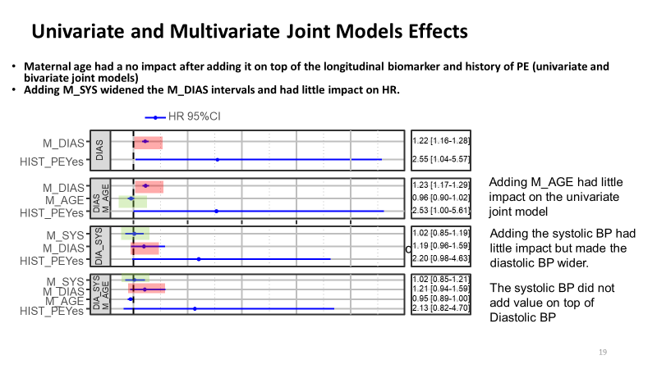
Other Uses: Compare across models (ACOP talk)

Slide 43
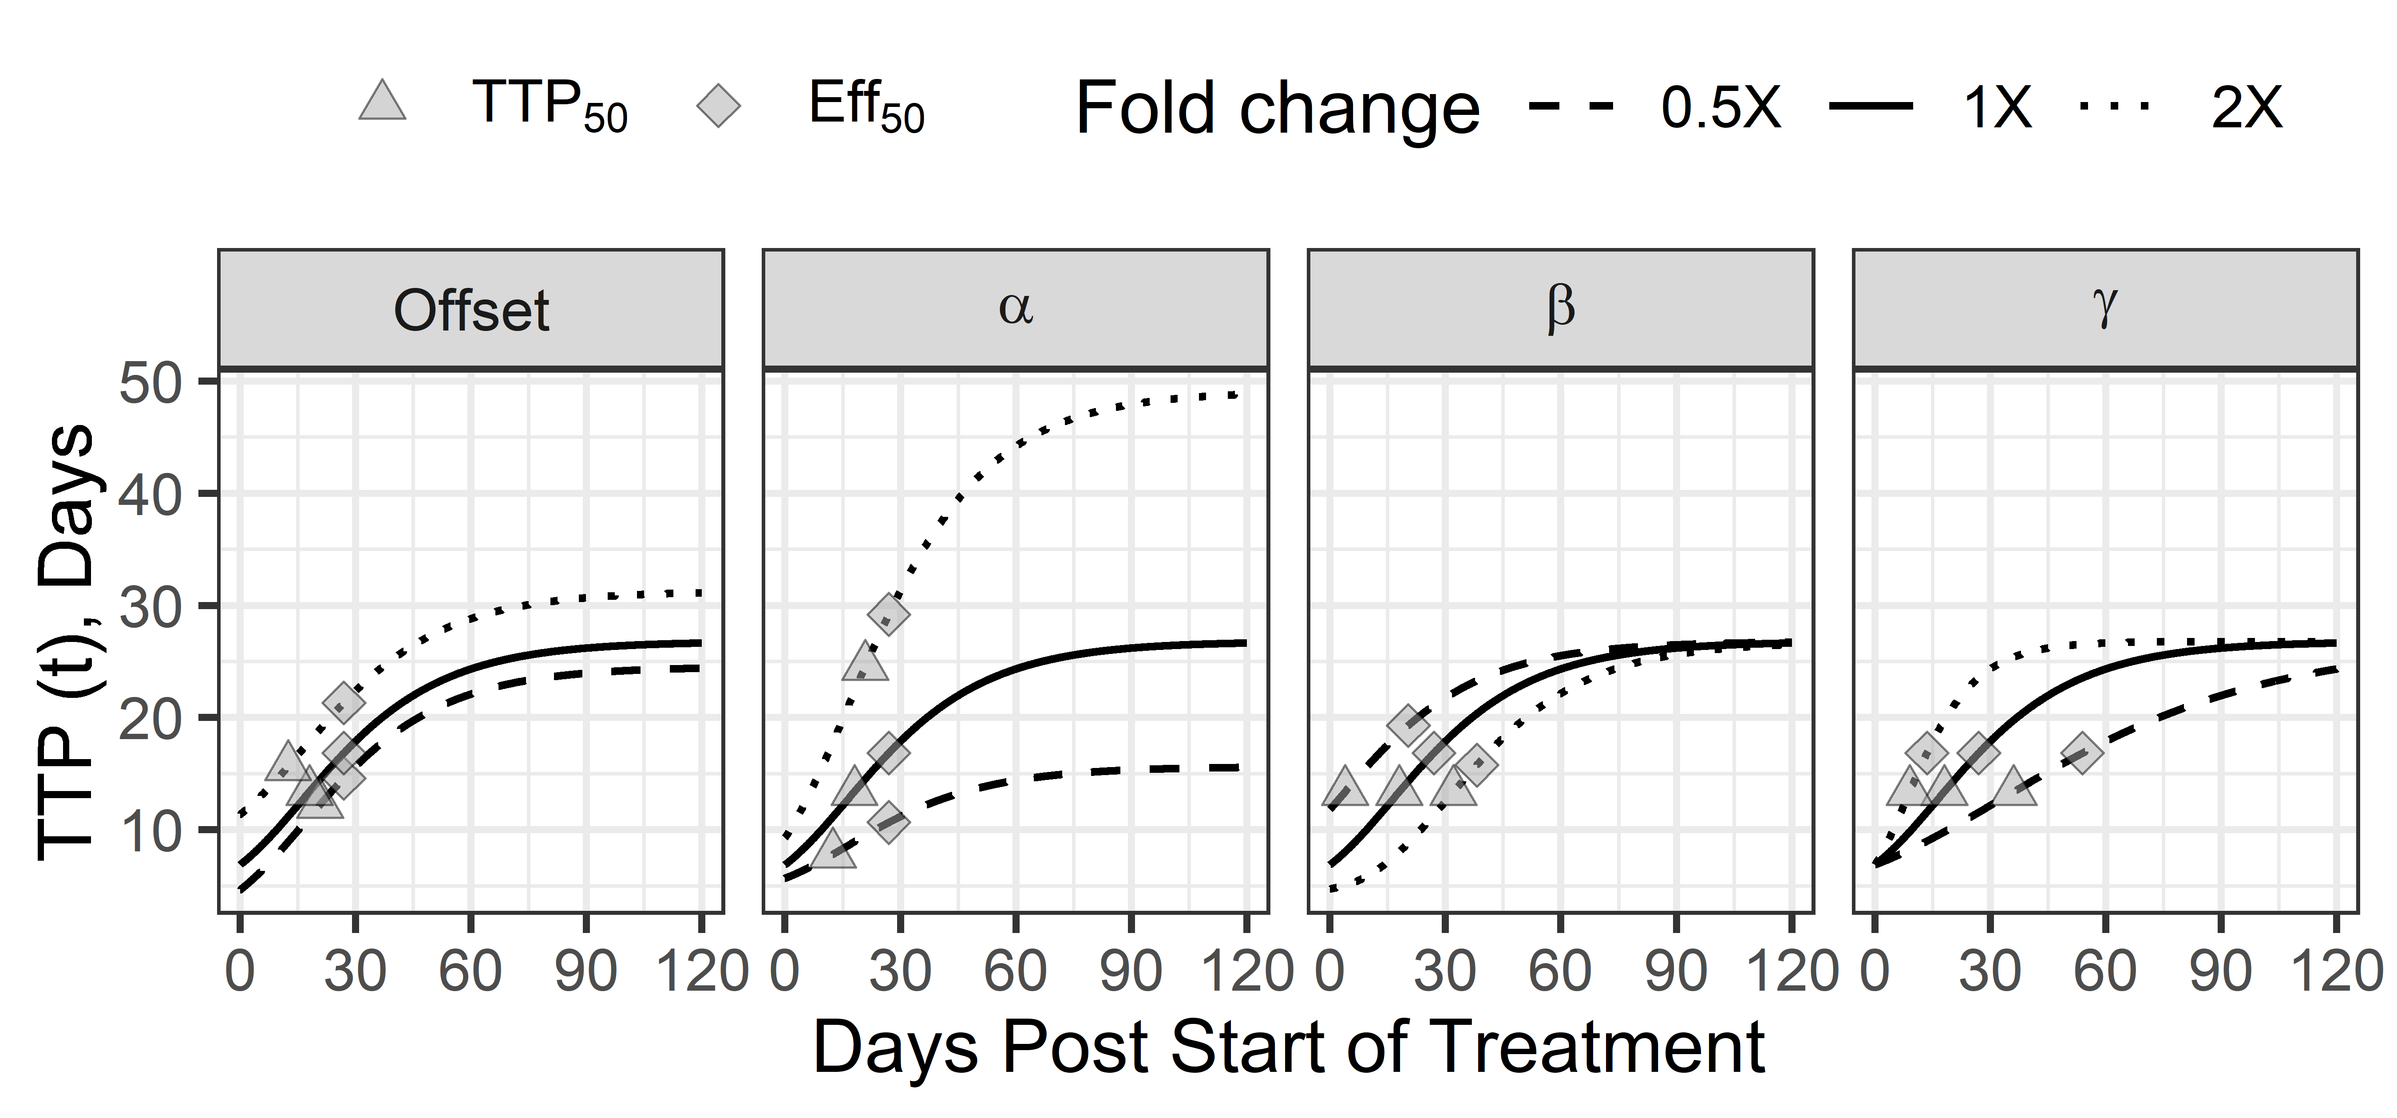
Impact on parameters and on the curve

Slide 44
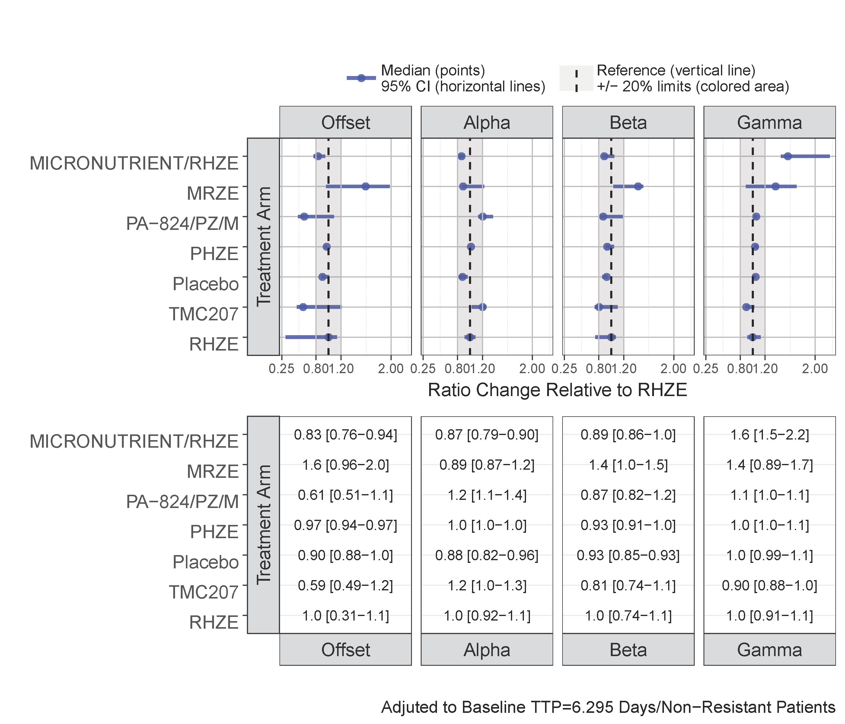
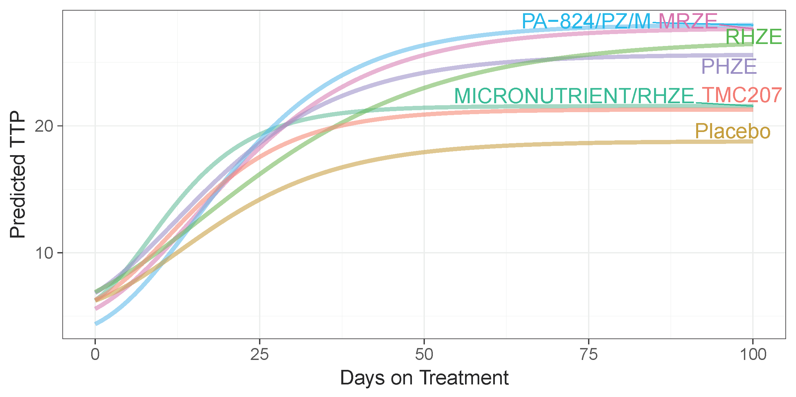
Impact on parameters and on the curve

Slide 45

Contributions/Next Steps
Covariate effects plots are useful to communicate pmx models
Current technologies and tools enable the user to generate the effects via intensive simulations with a reasonable time frame (seconds to minutes, live with the client)
The coveffectsplot package is:
Fitting software agnostic and has been used in multiple submissions/approvals
100% free and open source
Helpful for the generation of the graphics and include several applications examples, vignettes and a CPT:PSP tutorial

Slide 46

Contributions/Next Steps
The coveffectsplot package illustrates complete step-by-step frequently used workflows:
Univariate Simulations with Uncertainty with/without BSV
Multivariate Simulation with Uncertainty with/without BSV and with joint effects of realistic covariate distributions (including pediatrics)
The coveffectsplot package does not include automatic simulation / summarization (keep it open for the user)
Documentations improvements and features and pull requests are welcome

Slide 47
Questions
What is the best method to illustrate covariate effects univariate or multivariate and why ?
Do we need to include uncertainty on Omega ?
Why aren’t we using the residual error Sigma ?
Do we need to incorporate the uncertainty on the distribution of covariates ?
Can we illustrate the effects of “combinations” of covariates of interest?

Slide 48
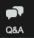
Questions ? Suggestions ? Comments ?
?
?

Slide 49
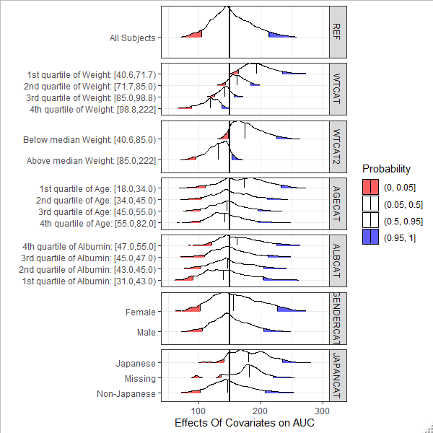
Other examples

Slide 50
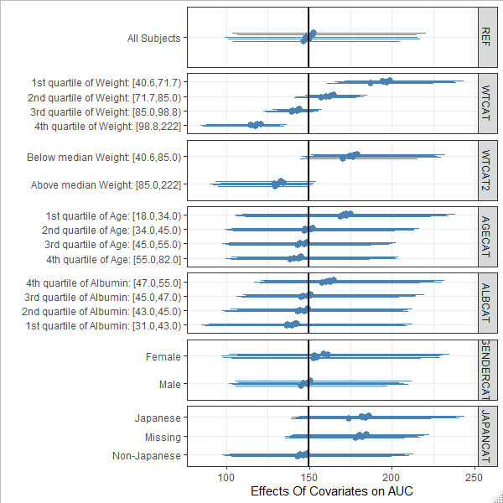
Other examples

Slide 51
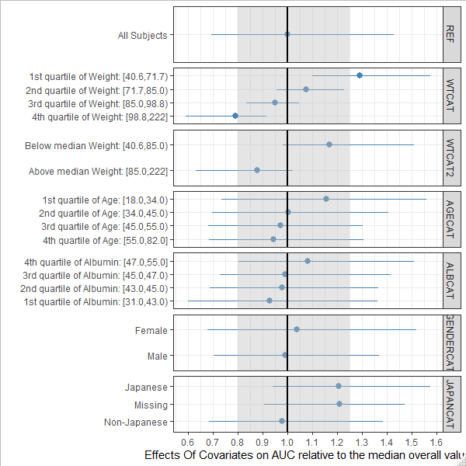
Other examples

Slide 52
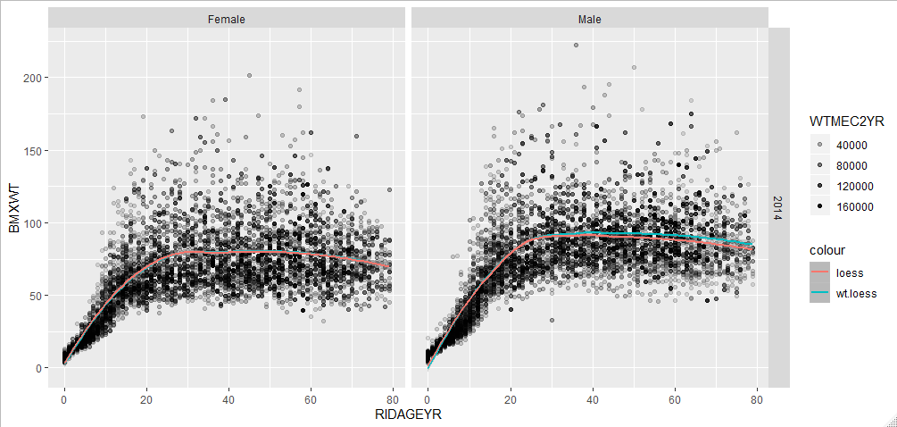
Plugging in Realistic Distributions in Pediatric simulations:
Transparency mapped to survey weight
Weighted LOESS
WTMEC2YR: is a variable provided by NHANES to appropriately weight the 2 years survey data
nhanesgamlss (github R package)
52

Slide 53
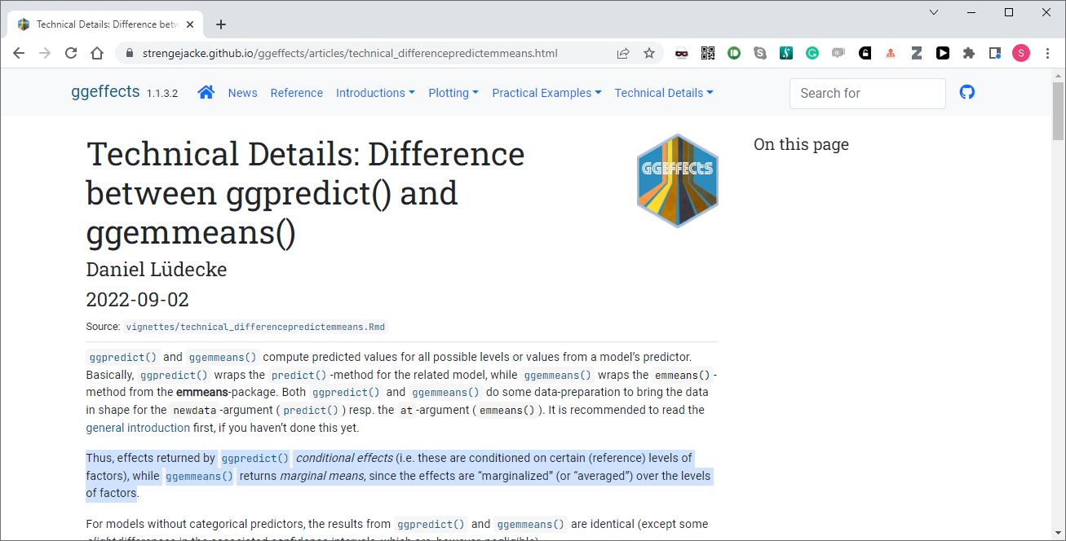
Effects plots in R/Stats

